Slide 1
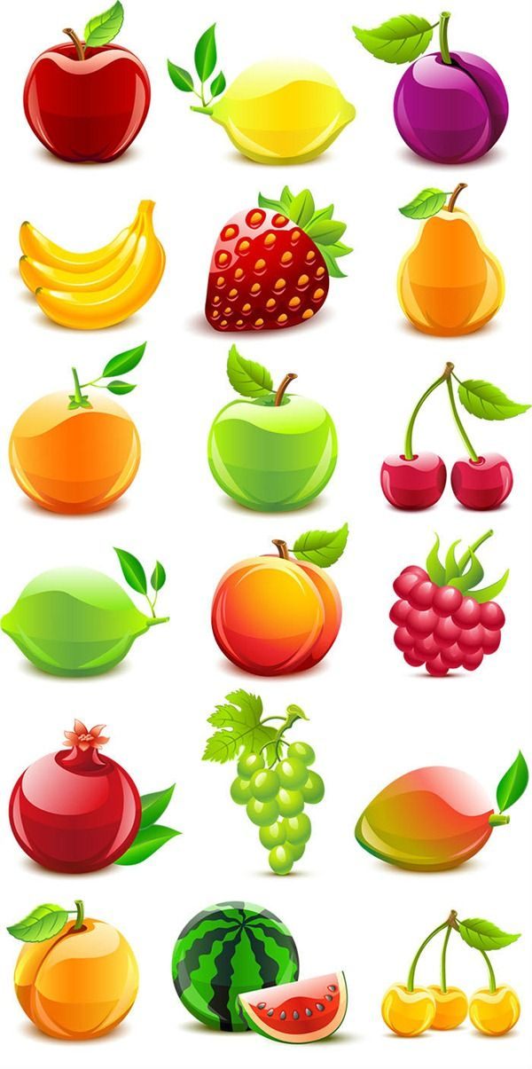
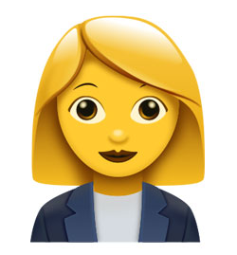


Item to Item Comparison
Purchases
+
+
User
Recommends
$$Σ$$
*
Item to Item
Comparison
=
Rating
Item Similarity Score
+
$$Σ$$
Item Similarity Score

Slide 4
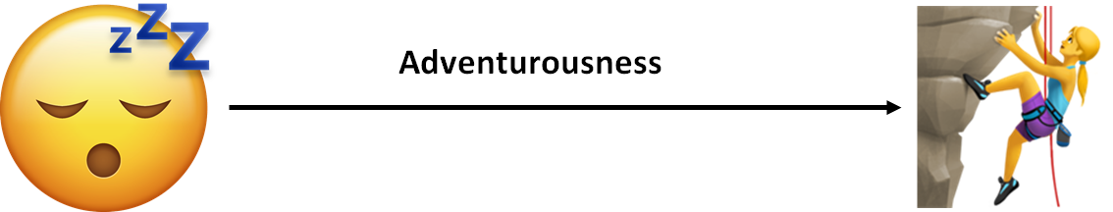
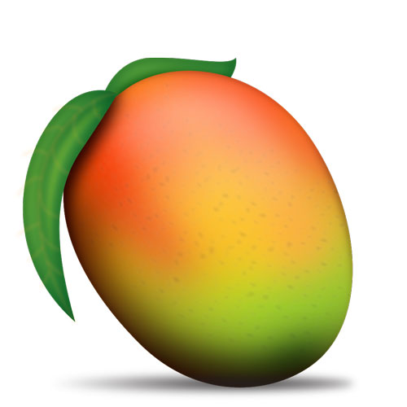
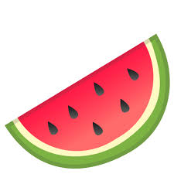
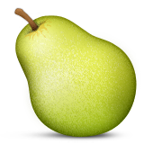
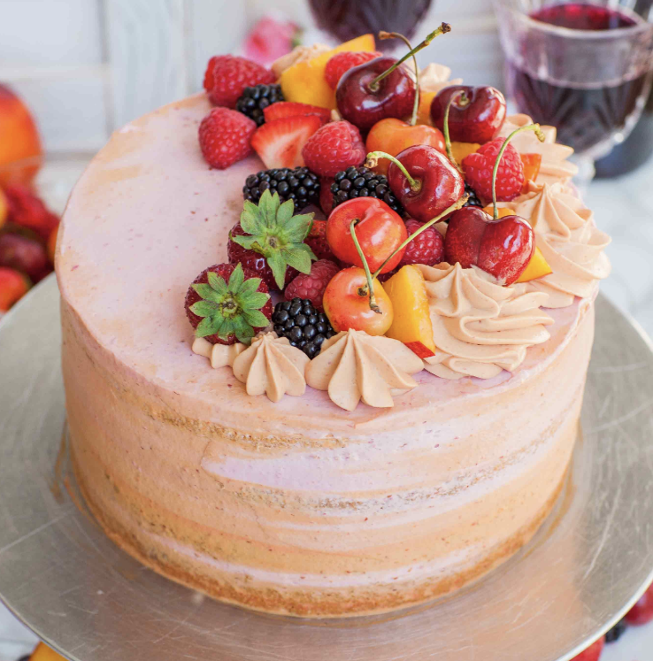
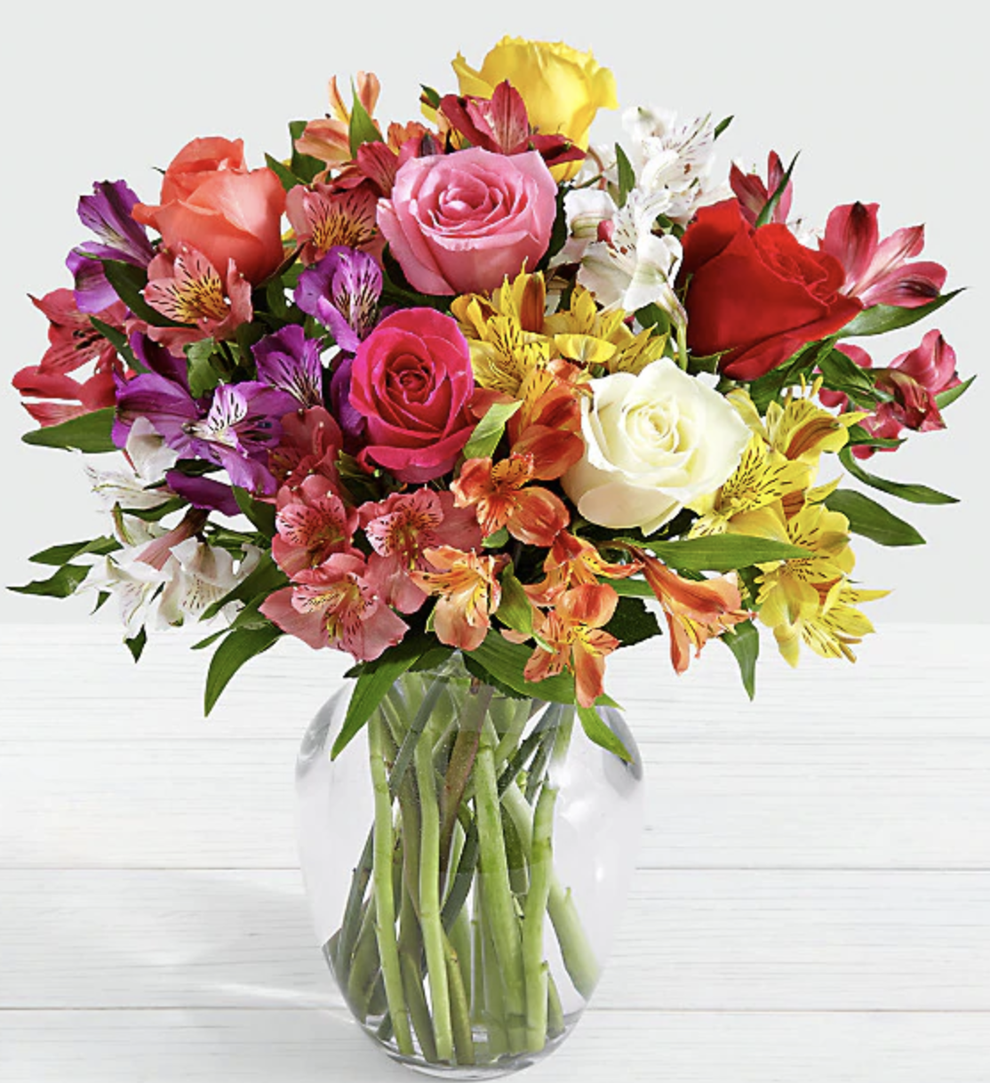
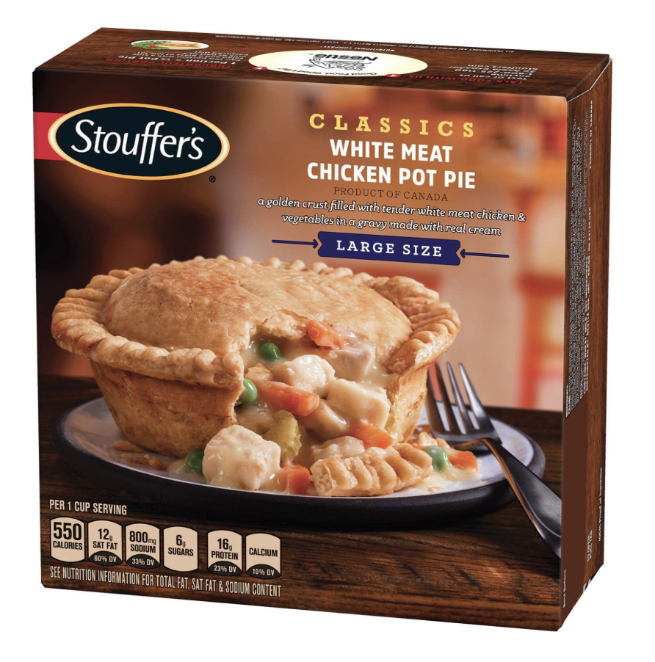
Similarity between orders
[
]
Similarity score: 0.9
[
]
Not adventurous user
[
]
Similarity score: 0
[
]
Adventurous
seeker
Notes:
To calculate the adventurousness we converted the words to numbers and compared the values. We split the scale of numbers by ranges to create two clusters: adventurous user who like to try new things and not adventurous users who purchase the same items all the time.

Slide 5
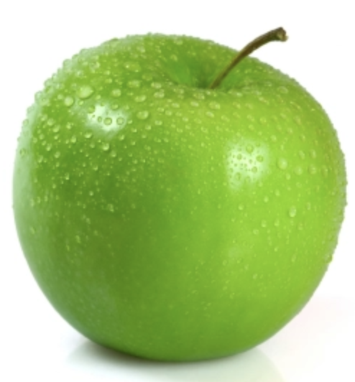
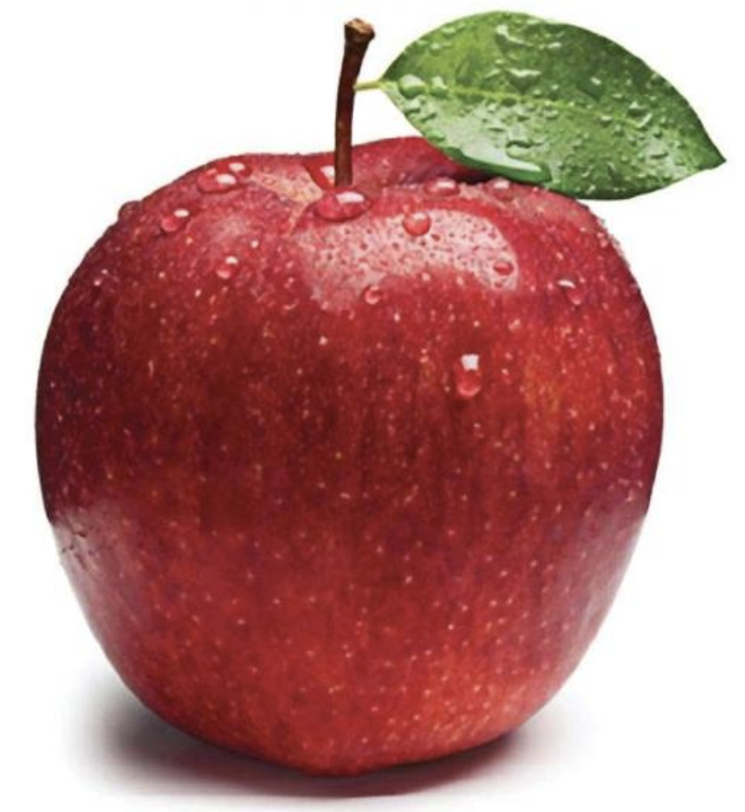
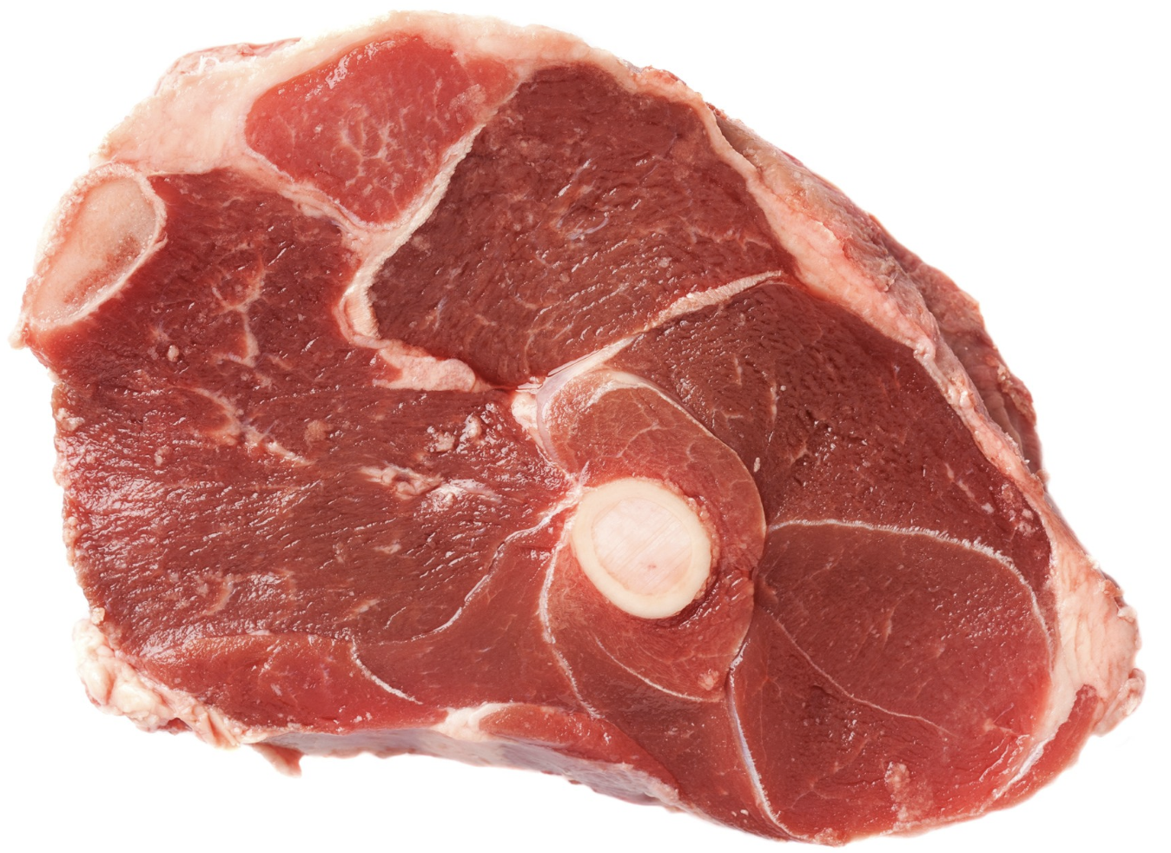
Similarity within orders
Green Apple
Red Apple
Beef Shank
[
]
0.95
0
Notes:
We used a word2vec method to find define similar items which a user puts in one basket. Word2vec transforms words to vectors and gives a pair of words a high score if words are close in meaning and low score if words are substantially different.

Slide 6
Adventurousness
Adventurous
score = 1
Adventurous
score = 0
Notes:
We defined the new feature - “adventurousness” of the user. We compare how much variety each user has in his orders. If user constantly buys exactly the same items, his “adventurous” score is 0, whereas if someone always buys new items, the score will be close to 1 .

Slide 7
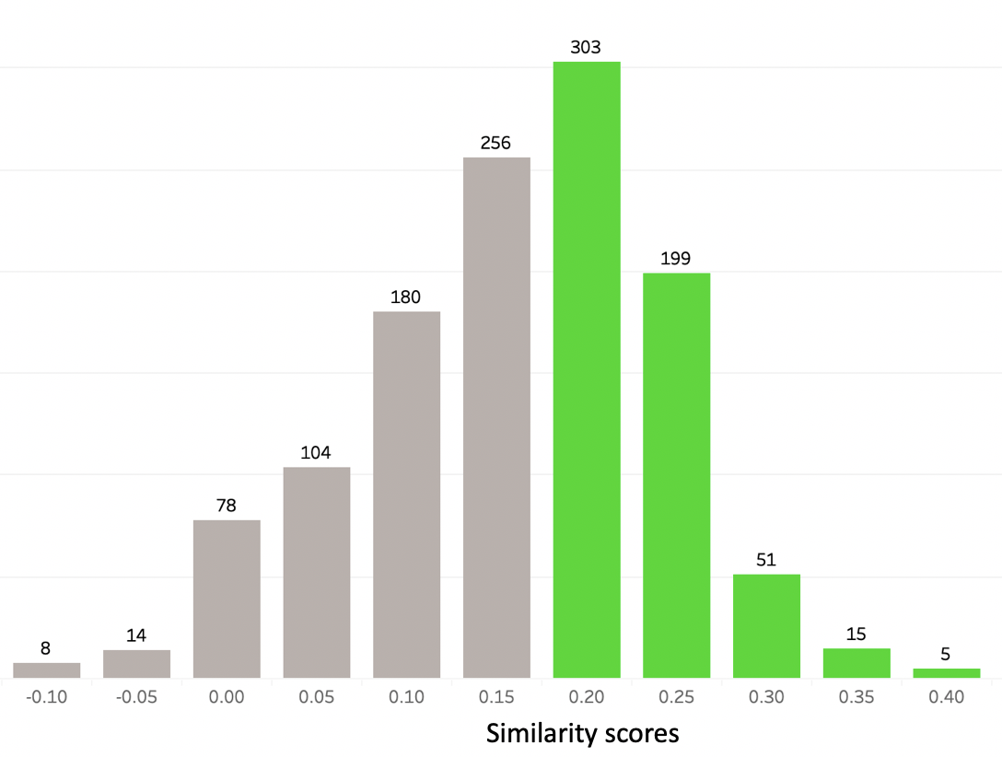
Stability connoisseurs
Adventure seeker

Slide 8
Old recommendation
❌ Honeydew Melon
❌ Yellow Bell Pepper
❌ European Cucumber
❌ Shredded Parmesan
❌ Almond Milk
❌ Organic Whole Wheat Bread
❌ 100% Whole Wheat Bread
Our recommendation
✅ Spring Water
✅ Soda
❌ Natural Artisan Water
❌ Petit Suisse Fruit
❌ Organic Diced Tomatoes
❌ Shredded Parmesan
❌ Organic Orange Bell Pepper
Actual order
✅ Spring Water
✅ Soda
Apples

Slide 9

THE END

